Slide 1
A haunting issue : the destiny of plutonium
Alain MICHEL
ANS , September 16, 2014

Slide 2
What’s the situation ?
From International Panel on Fissile Materials (IPFM ) Jan 2013
Based on 2011 declarations to IAEA andestimates

Slide 3
Origins of the civilian stocks of separated plutonium
Great-Britain: systematic national reprocessing, no recycling
Japan : reprocessing mainly in Europe until now, low recycling thus stored mainly in Europe reprocessing plants
France : systematic national reprocessing, insufficient recycling
Russia: reprocessing and partial recycling in FBR
Germany : systematic reprocessing and recycling but halted thus stored at the reprocessing plants
Belgium and Switzerland : no stocks as all reprocessed plutonium was recycled

Slide 4
The example of a succesfull planned development in Belgium

Slide 5
Belgium receives plutonium (around 1960)
Transport of one of the first delivery of american Pu from Antwerp harbour to SCK-CEN

Slide 6
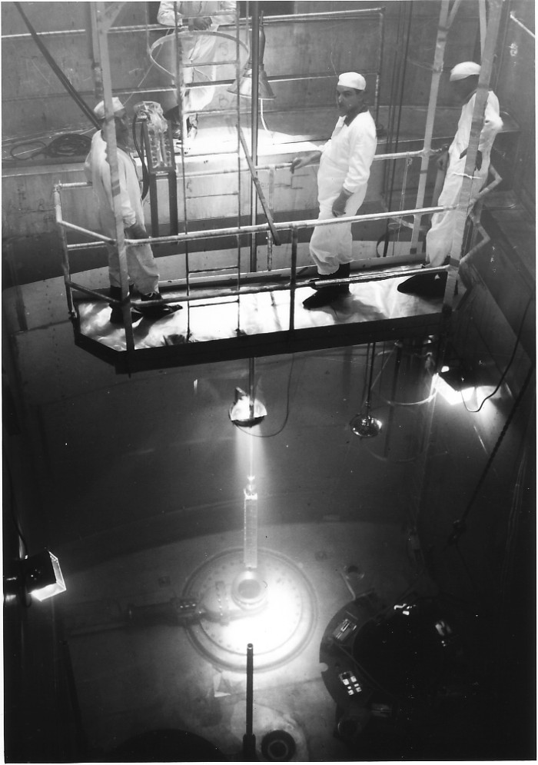
A common group SCK-CEN with BN (the sixties)
Laboratories and pilot plant at SCK-CEN
World première : MOX in BR3 (1963)

Slide 7
BN builds an industrial plant (the seventies)
The Dessel BN plant
in its first years

Slide 8
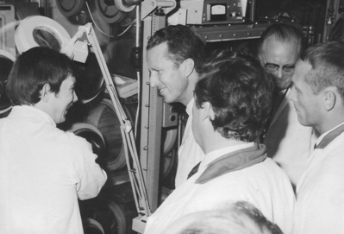
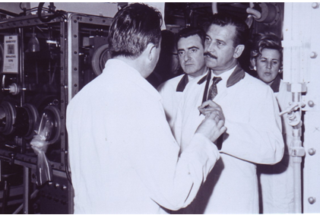
Political support during the first years of activity
King Baudouin
Minister Cools
SNR MkI core and irradiations
with Governments financing

Slide 9
Industrial maturity (the eighties)
Manufacturing MOX fuel for LWR in
France, Germany, Switzerland, Japan and Belgium
but also smaller amounts for Italy, Netherland, Sweden
( situation end of 2005)

Slide 10
Full capacity until 2005
Belgonucleaire ,
world leader in MOX fuel,
has fabricated 660 tonnes
of MOX fuel – (that is 80 reloads) in more than
20 years operation.
Thus some 40 tonnes of Pu have been recycled.

Slide 11
Dismantling now
First procedures in 2006, dismantling until 2015.
Had the attitude of the Belgian government be less hesitant, this plant could have been a solution to the present US situation as we will see later.

Slide 12
This does not mean that there were no political obstacles

Slide 13
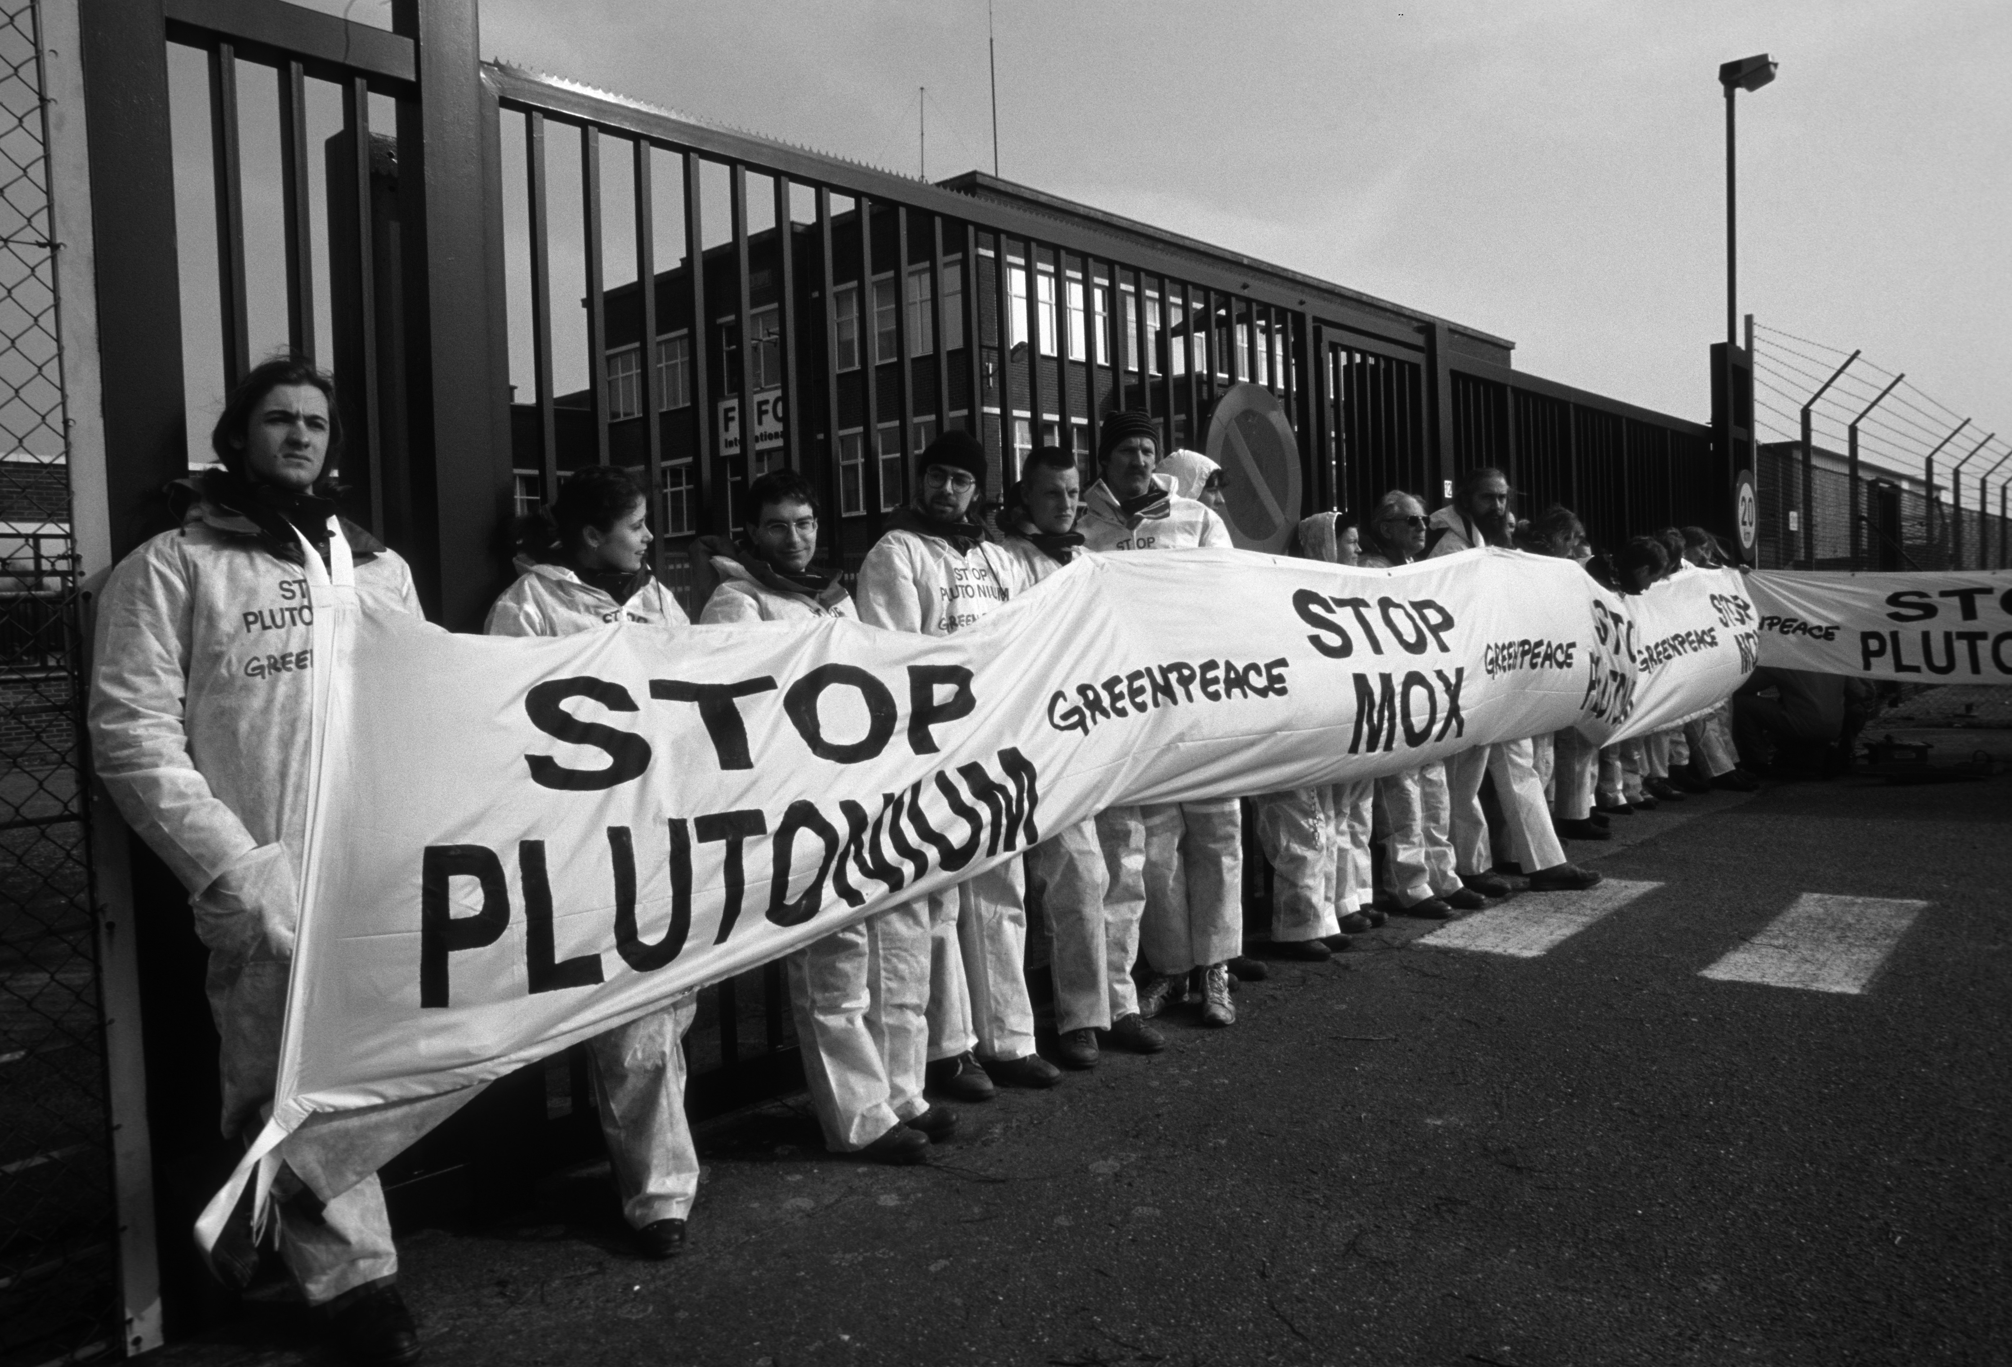
One example: the failure of the extension
BN, in cooperation with COGEMA, obtains the licence to double its plant capacity (1991)
But a small fault in the procedure detected by Greenpeace, ruins the project

Slide 14
The situation of military stocks
Russia : the largest stocks, less than a third considered in excess
USA : also large, more than half considered in excess
Great-Britain : small, partly considered in excess
France : small, none in excess
China : small, none in excess
Others : secret, very small and « illegal » estimated presence in Israël, India, Pakistan, North Corea, …

Slide 15
Past production of US weapons-grade plutonium

Slide 16
Probably one of the first proposal of a method to reduce stocks came from Belgium, based on its recycling know-how
One of the few places in those days (1989) where US, Russian and Europeans experts could exchange ideas freely …

Slide 17
Chronology of the international discussions (1)
Sept. 93: Pres. Clinton commits to seek to eliminate stocks of plutonium
1994 : NAS report recommends immobilization with HLW or MOX irradiation
March 1, 95 : USA declares 38.2 t surplus WG + 14.3 t non WG plutonium excess
April 96 : G7+1 at Moscow summit joint statement on the need to make excess fissile material unusable for weapons.

Slide 18
Chronology of the international discussions (2)
Jan 97 : USA examines 37 ways of disposition and confirms NAS choice. Russian president Yeltsin declares 50t WG plutonium excess
Sept. 2000 : USA and Russia sign PMDA to dispose of 34 t each as MOX in LWR
2010 : the PMDA is modified to accept Russian FBR policy

Slide 19
Steps in the US MOX policy
1994 : MOX is one alternative for NAS
Numerous reexamination reconfirm this choice in 97 (against 37 options), 2002 (40 options, 12 considered seriously), 2006-07, …
2008 : MFFF is estimated $4.8 billions to operate in 2016.
2012: Reviewed at $7.7 billions and 2019

Slide 20
Will MFFF ever be operational ?
After Belgians early proposal, BN participates in designing plants but finally MFFF is build in the USA with Areva and Shaw after heavy local objection actions. Presently it is not certain that it will be operated …
Situation last spring : a new report compared five options

Slide 21
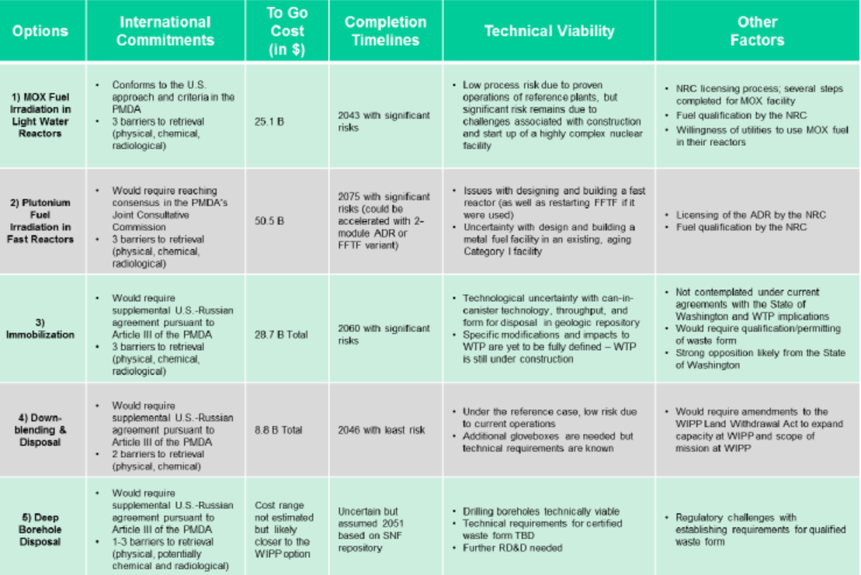
DoE , April 2014

Slide 22
MFFF cut out of DoE’s budget
NNSA responsible for non-proliferation activities including Pu disposition program and maintenance of nuclear arsenal.
Requested $11.7 billion but nothing for MFFF due to expected cost overrun. Thus in cold stand-by until further examination.
Comment by Areva: cold standby is an euphemism for termination

Slide 23
Meanwhile, Russia starts a 800 MWe plutonium fast breeder
BN800 FBR has just reached criticality last June. It is loaded with MOX and will thus contribute to the reduction of weapons grade stocks. Three 1200 Mwe are planned

Slide 24
Anxieties in fictions and demonstrations

Slide 25
Plutonium : notions that have a strong emotional impact
Plutonium is an infernal name
Nagasaki was a sin against mankind
24,000 years half-life looks very much like eternity
All types of plutonium are weapon usable
Internet technology allows every terrorist to build a bomb in his garage, so plutonium is the essence of nuclear proliferation
1 millionth of a gram is sufficient to cause a death by cancer

Slide 26
Plutonium : the myths
Pluto, god of inferno
although he was god of underground’s wealth and his
name means “the rich”
Apocalypse
due to a strong association in people ’s mind with the bomb, stronger than uranium
Dragons and phoenix
underground energy, perpetual rebirth, impossible to exterminate

Slide 27
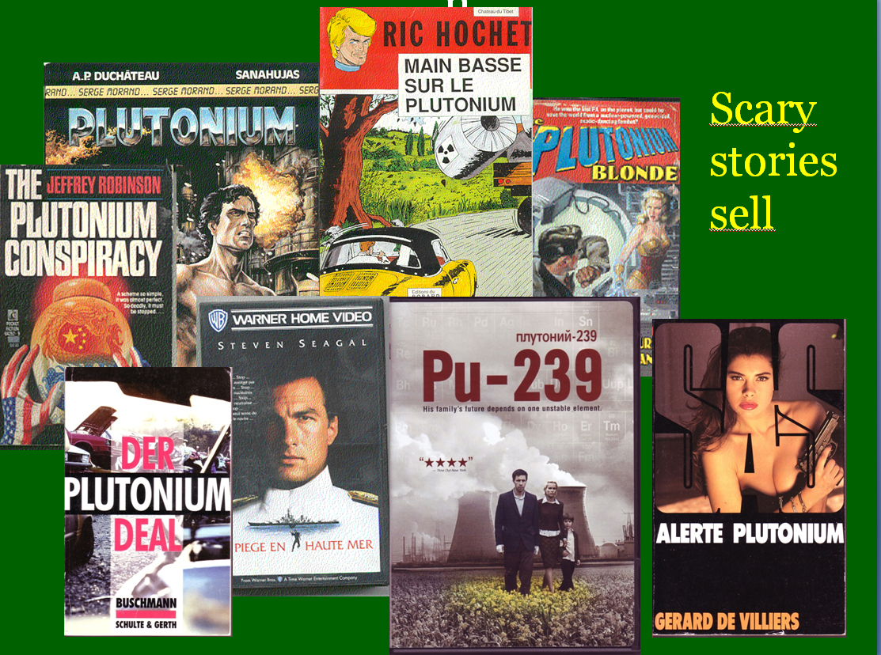

Slide 28
A recent novel placed in Hanford
« Covington Nuclear » is in charge of dismantling the plutonium installations but it uses this « cover » to develop secretly a nuclear trigger that it might sell when proven. This leads to an unexpected explosion …
Guards and workers try to prove their contamination that the company refuses to admit.

Slide 29
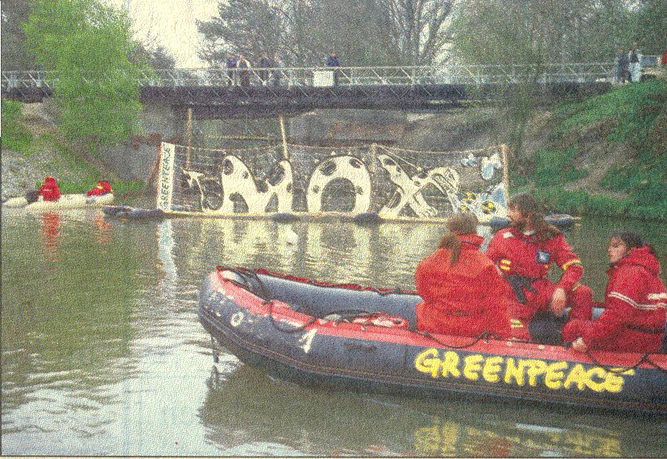
Green Actions : Greenpeace in Dessel
Plutonium branded as the most dangerous substance in the world represents a considerable propaganda coup for the green movement
(Gordon Adam, MEP, at Pu 2000)

Slide 30
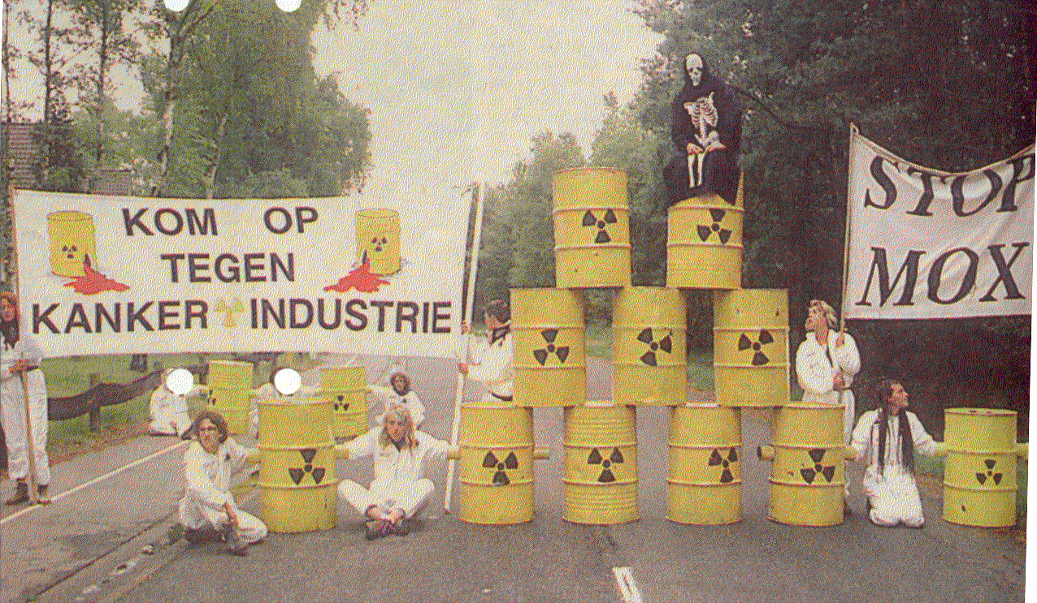
Green Actions : Mother Earth
Cancer and death, the utmost scares … (road blockade in Dessel, 1993)

Slide 31
Misinformation and distortion of facts
Extracts from the « case study », a transport of fresh MOX:
A storm alters the course of the Mairi Maru, which runs aground on a sandbar (…) The ship’s (double) hull rupture, as does the secure compartment holding the MOX canisters. The canisters, also damaged, leak over 50 kg of highly radioactive MOX pellets (…) Several members of the crew die and others exhibit acute radiation syndrome. (…) presence of dead fish and sea birds in an area of up to 15 km from the wreck three days later.
February 2005

Slide 32
Emotional fears
« There is no other domain where opinion even of educated persons, is so far from facts (…) There is no other domain where passion so clearly overcomes reason »
Jean de Kersvadoué
For Hollywood, « The first rule in movie making is not to let the truth get in the way of a good story ».
Wayne Smith

Slide 33
How can we react ?

Slide 34
Shall we also use emotions ?
« Only a fringe – uncertain, indecisive – of society is accessible to the truth, thus to debate ».
Bernard-Henry Levy
« It is impossible to engage in a rational dialogue with a person about beliefs and concepts that were not acquired by the way of reason »
Carlos Ruiz Zafon

Slide 35
Targeting hearts and guts
« You can pound them with facts all you want. They’re just going to clamp their hands over their ears until you figure out a more indirect pathway to their brains »
If our stories « can create an atmosphere of fun, there are no limits on popularity »
Randy Olson

Slide 36
But to be memorized, a message requires :
To charm
To stir
To convince
In this order, already according to Cicero …

Slide 37
Streamlining arguments for the public
Try to avoid the assimilation of plutonium with waste but do not push forward the economic interest of recycling
Reconnect plutonium with reactor operation and not with eternal existence and disposal
Reassure on the safety of the used process, the negligible health and environmental impact

Slide 38
Fundamental messages:
plutonium is not a waste : it is a by-product of nuclear energy
plutonium can be managed in a safe and secure way with available technology and facilities, by burning it in existing reactors where it belongs

Slide 39
So what ?

Slide 40
Plutonium means wealth …
Humanity has learned to appreciate the use of fire indispensable in a civilized world, and balance its advantages against the dangers of using it. It may be possible that with time, the same might happen for plutonium, indispensable if we want nuclear energy to be considered a sustainable source of energy
Catherine Tissot-Colle, Cogema at Pu 2000 conference

Slide 41
Probably lacking today
« Aujourd’hui, pour vivifier l’interface entre science et société, il nous manque un Jules Verne. Les angoisses contemporaines au sujet du rationnel et des techniques associées tiennent en partie à ce manque. »
Michel Serres (Préface de Jules Verne, De la science à l’imaginaire)

Slide 42
Dreams are needed to be creative
« To demonstrate the importance of new technologies in the sustainable development but also to bring back dreams and emotions at the heart of the scientific undertakings »
Project Solar Impulse
of Bertrand Piccard

Slide 43
But indifference will probably be the first step …
We need supporters but success will probably be obtained when only few people will really care : indifference will mean that scare is gone.
Paul Valéry already wrote years ago that : « any policy is based on the indifference of most concerned people, without which no policy is possible »

Slide 44
Thank you

